Slide 1
Cornerstone City Church Peninsula Plus Community Hoo Are Ya
31st August 2025

Slide 2
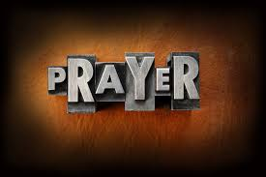

Slide 3
Thanksgiving
CCLI Song # 7199589
Nick Herbert | Taku Mudere | Zo Chilengwe
© Capitol CMG Genesis; Safe and Sound Music; Remaining portion is unaffiliated
For use solely with the SongSelect® Terms of Use. All rights reserved. www.ccli.com
CCLI Licence No. 33265

Slide 4
1/10
Enter in (Enter in)
His courts with praise (His courts with praise)
For He is greatly (He is greatly)
To be praised (To be praised)

Slide 5
2/10
Enter in (Enter in)
His courts with praise (His courts with praise)
For He is greatly (He is greatly)
To be praised

Slide 6
3/10
What shall we do
We shall lift up a shout
What shall we do
We shall praise Him
What shall we do
For our God made a way
We'll give Him our thanksgiving

Slide 7
4/10
Magnify (Magnify)
His Holy Name (His Holy Name)
For He is greatly (For He is greatly)
To be praised (To be praised)

Slide 8
5/10
Magnify (Magnify)
His Holy Name (His Holy Name)
For He is greatly (For He is greatly)
To be praised

Slide 9
6/10
What shall we do
We shall lift up a shout
What shall we do
We shall praise Him
What shall we do
For our God made a way
We'll give Him our thanksgiving

Slide 10
7/10
Even if the rocks cry out
We're gonna drown them out
With a louder shout of praise
Even when the battles roar
We're gonna praise You Lord
'Cause You are always worthy

Slide 11
8/10
You are worthy
Worthy of honour and praise
You are worthy
We'll sing it again and again

Slide 12
9/10
What shall we do
We shall lift up a shout
What shall we do
We shall praise Him
What shall we do
For our God made a way
We'll give Him our thanksgiving

Slide 13
10/10
We'll give Him our thanksgiving
We'll give Him our thanksgiving

Slide 15
10,000 Reasons
CCLI Song # 6016351
Jonas Myrin | Matt Redman
© 2011 Thankyou Music (Admin. by Integrity Music Ltd)
Atlas Mountain Songs (Admin. by SHOUT! Music Publishing UK)
For use solely with the SongSelect® Terms of Use. All rights reserved. www.ccli.com
CCLI Licence No. 33265

Slide 16
1/7
Bless the Lord O my soul O my soul
Worship His holy name
Sing like never before O my soul
I'll worship Your holy name

Slide 17
2/7
The sun comes up it's a new day dawning
It's time to sing Your song again
Whatever may pass and whatever lies before me
Let me be singing when the evening comes

Slide 18
3/7
Bless the Lord O my soul O my soul
Worship His holy name
Sing like never before O my soul
I'll worship Your holy name

Slide 19
4/7
You're rich in love and You're slow to anger
Your name is great and Your heart is kind
For all Your goodness I will keep on singing
Ten thousand reasons for my heart to find

Slide 20
5/7
Bless the Lord O my soul O my soul
Worship His holy name
Sing like never before O my soul
I'll worship Your holy name

Slide 21
6/7
And on that day when my strength is failing
The end draws near and my time has come
Still my soul will sing Your praise unending
Ten thousand years and then forevermore

Slide 22
7/7
Bless the Lord O my soul O my soul
Worship His holy name
Sing like never before O my soul
I'll worship Your holy name

Slide 24
Goodness Of God
CCLI Song # 7117726
Ben Fielding | Brian Johnson | Ed Cash | Jason Ingram | Jenn Johnson
© 2018 Capitol CMG Paragon (Admin. by Capitol CMG Publishing)
Fellow Ships Music (Admin. by Essential Music Publishing LLC)
So Essential Tunes (Admin. by Essential Music Publishing LLC)
SHOUT! Music Publishing Australia (Admin. by SHOUT! Music Publishing UK)
Bethel Music Publishing (Admin. by Song Solutions)
For use solely with the SongSelect® Terms of Use. All rights reserved. www.ccli.com
CCLI Licence No. 33265

Slide 25
1/6
I love You Lord
Oh Your mercy never fails me
All my days
I've been held in Your hands
From the moment that I wake up
Until I lay my head
I will sing of the goodness of God

Slide 26
2/6
All my life You have been faithful
All my life You have been so so good
With every breath that I am able
I will sing of the goodness of God

Slide 27
3/6
I love Your voice
You have led me through the fire
In darkest night
You are close like no other
I've known You as a father
I've known You as a friend
I have lived in the goodness of God

Slide 28
4/6
All my life You have been faithful
All my life You have been so so good
With every breath that I am able
I will sing of the goodness of God

Slide 29
5/6
Your goodness is running after
It’s running after me
(REPEAT)
With my life laid down
I’m surrendered now
I give You everything
Your goodness is running after
It's running after me

Slide 30
6/6
All my life You have been faithful
All my life You have been so so good
With every breath that I am able
I will sing of the goodness of God

Slide 31
1/2
I see the evidence of Your goodness
All over my life
All over my life
I see Your promises in fulfillment
All over my life
All over my life

Slide 32
2/2
See the cross the empty grave
The evidence is endless
All my sin rolled away
Because of You oh Jesus (oh)

Slide 33


Slide 34
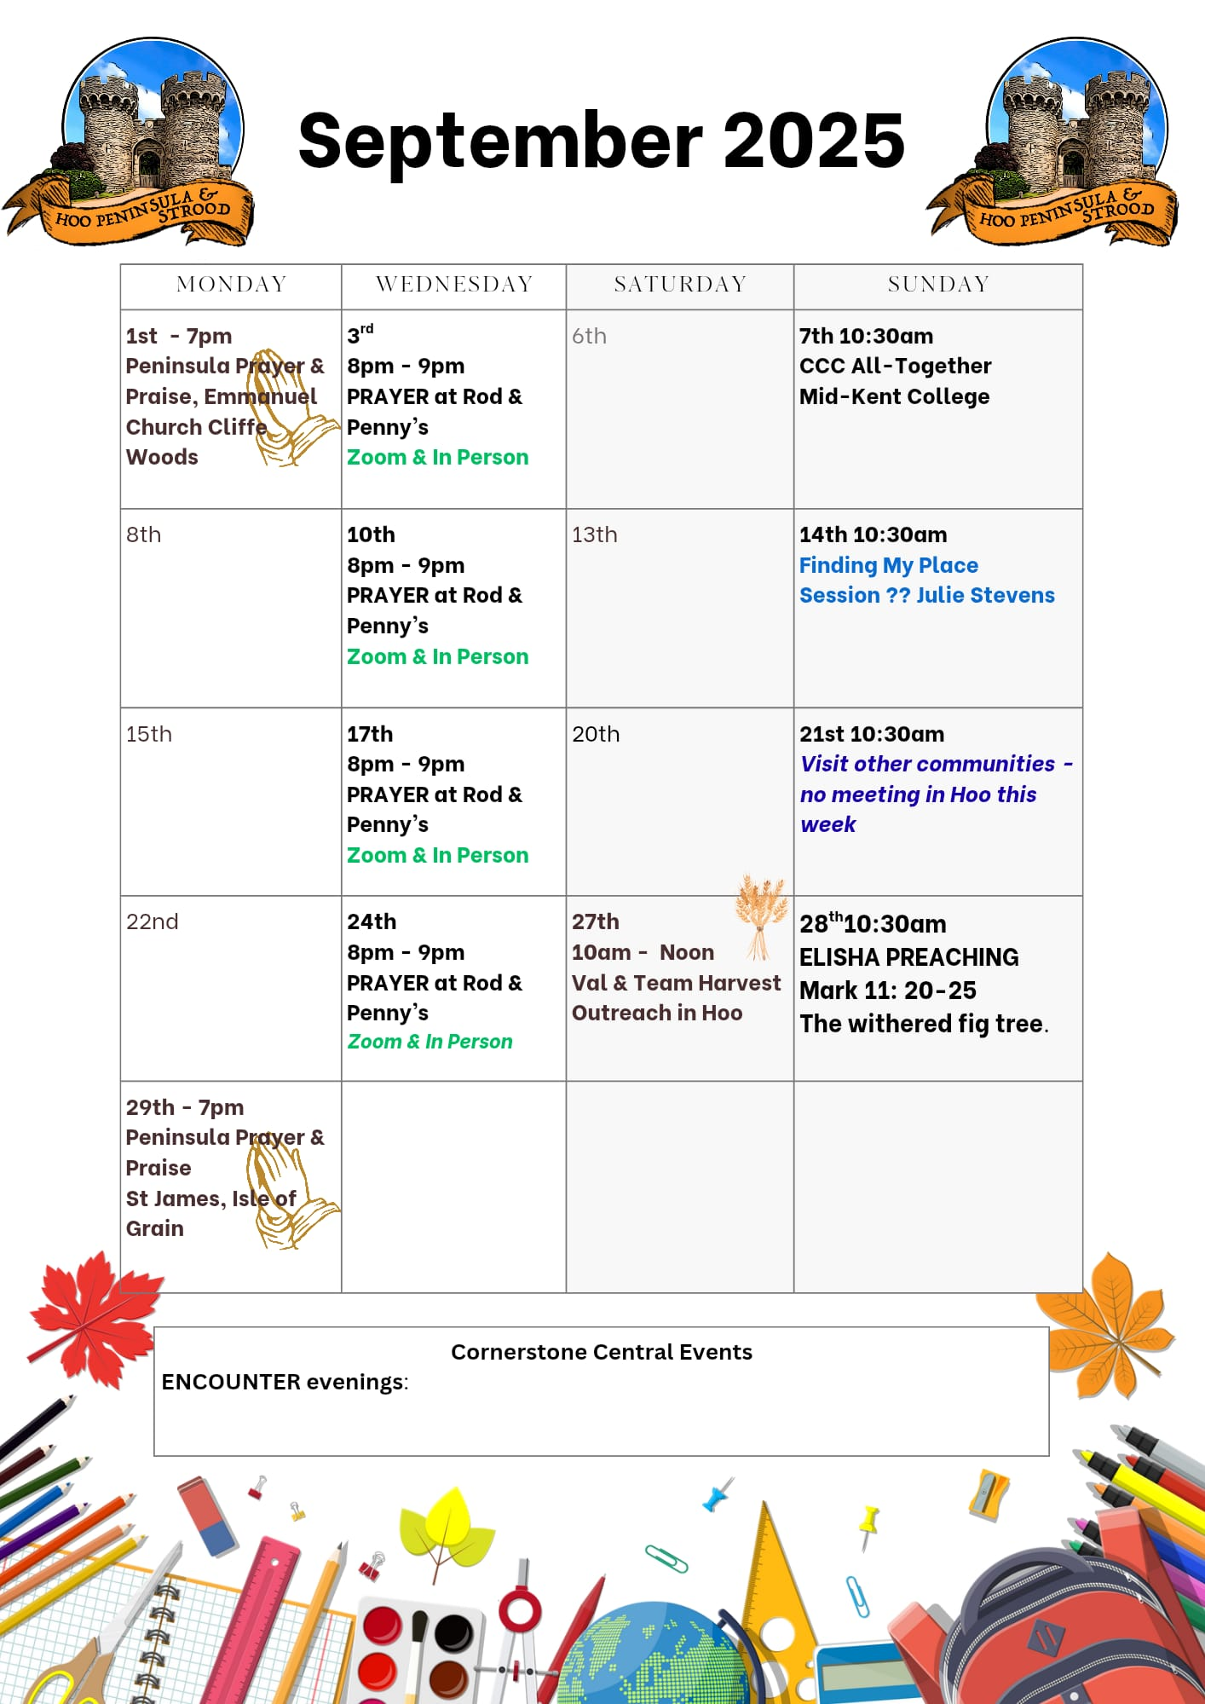

Slide 35

Grow Group 1
On YOUR MARK!

Slide 36
Leaders
Leaderss
Phil & Kim
Maria (Mia) Warren
Matthew Harrison
Richard & Elisha Acheampong
Phil & Kim
Maria (Mia) Warren
Matthew Harrison
Richard & Elisa Acheampong

Slide 37
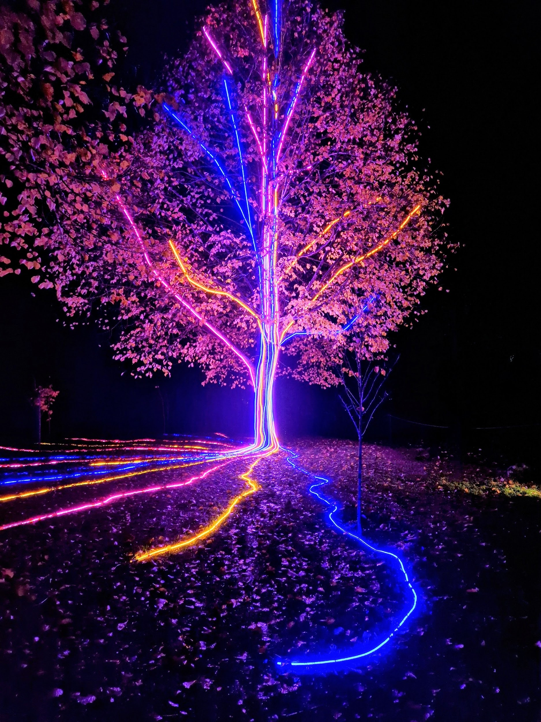
Storm Walker
Storm Walker
Symbolising, trust in Jesus Christ through life's storms.
Mark 4:35-41

Slide 38
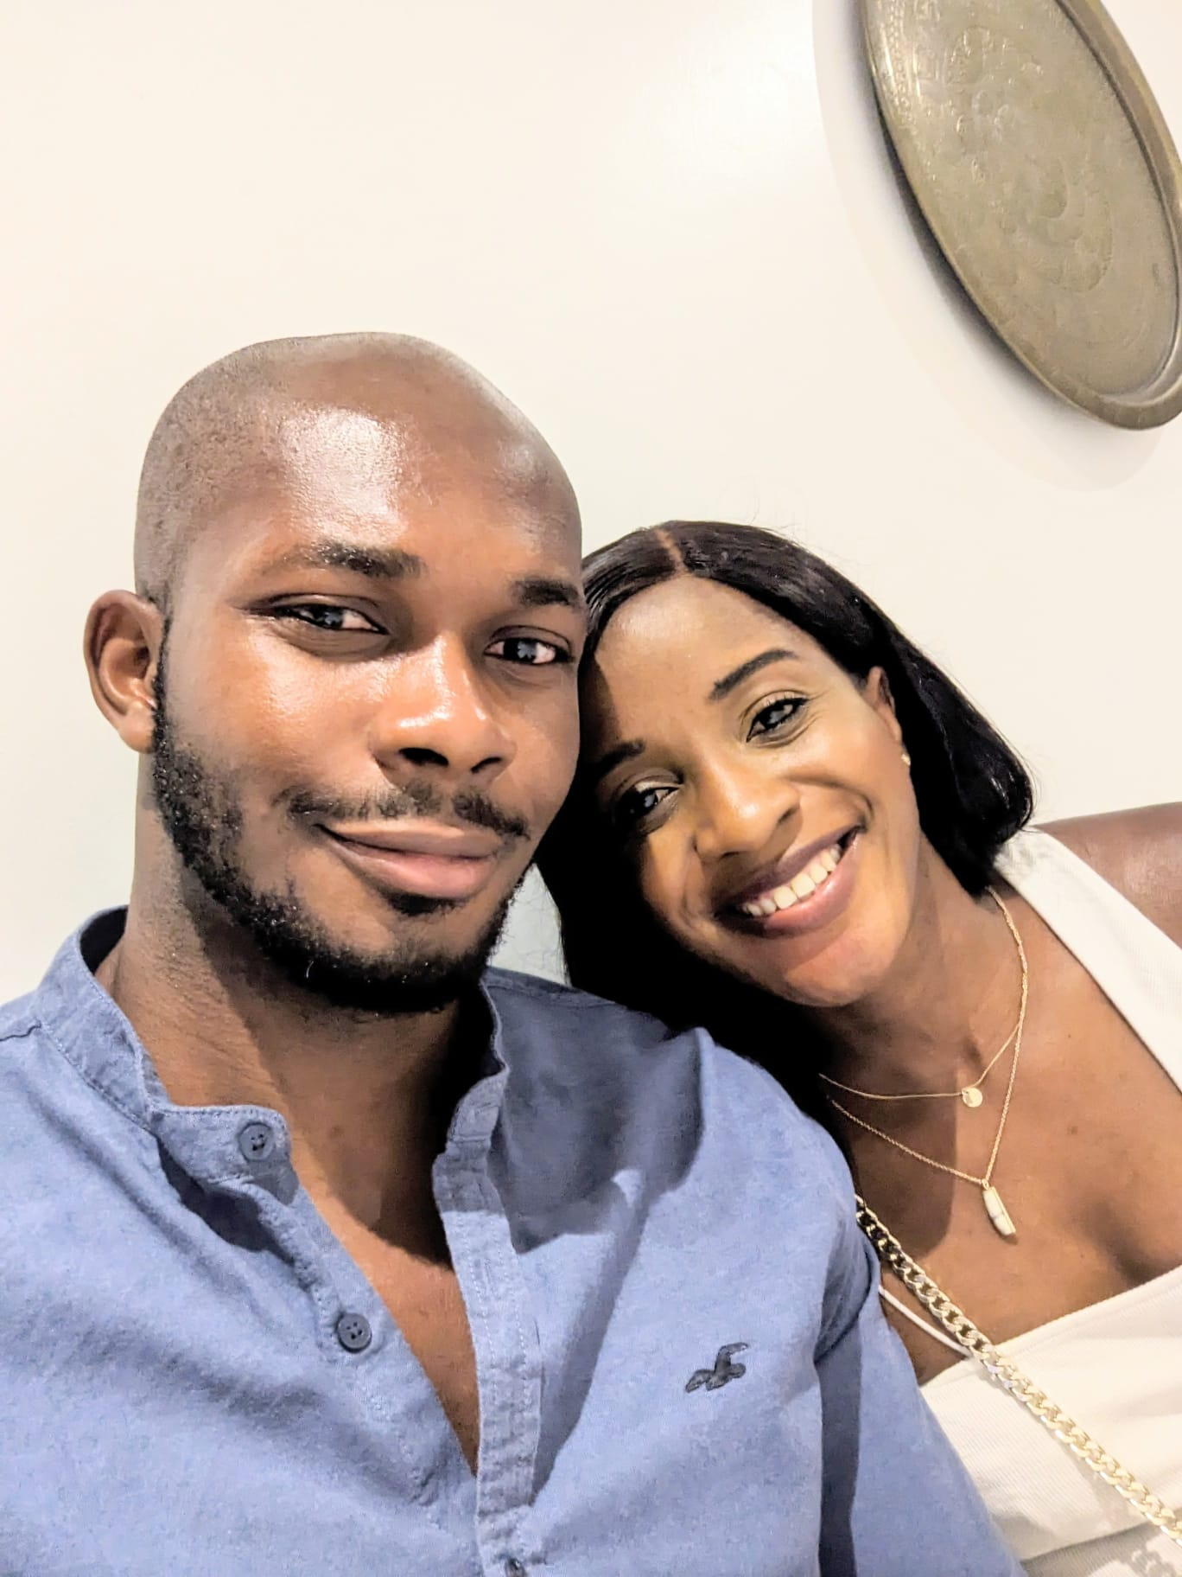

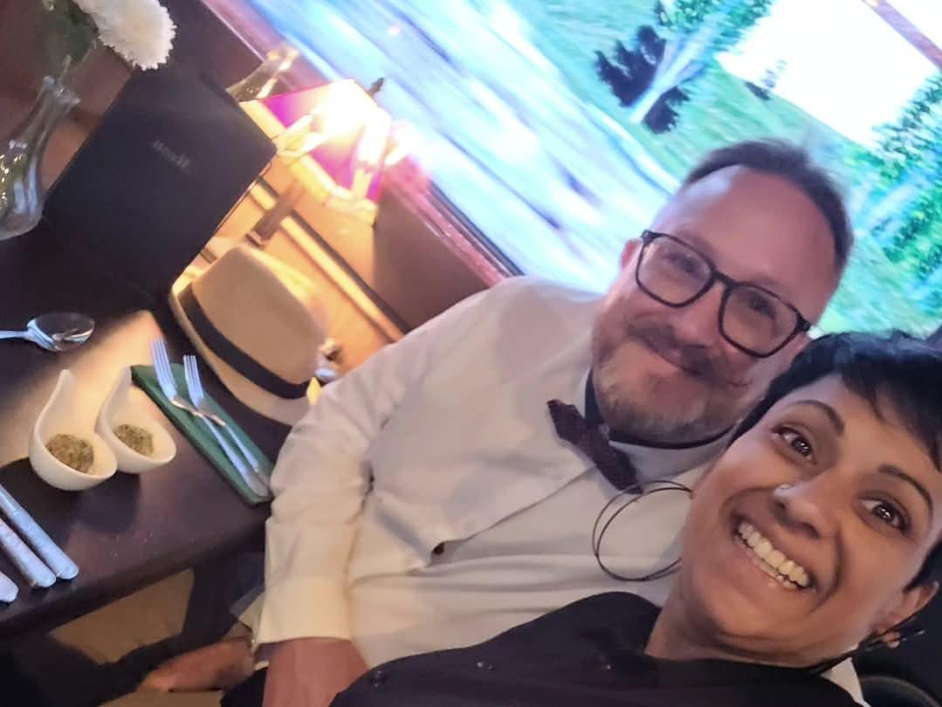
Group Leaders
Micheal and Mwamba
Wilfred and Parveen
Hannah

Slide 39
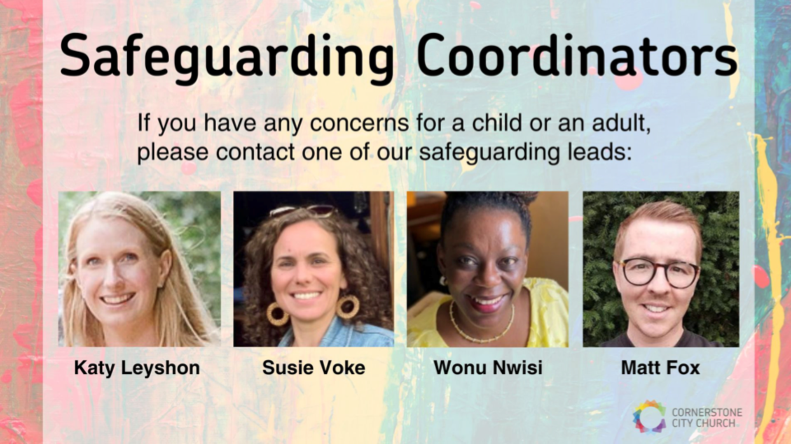

Slide 40
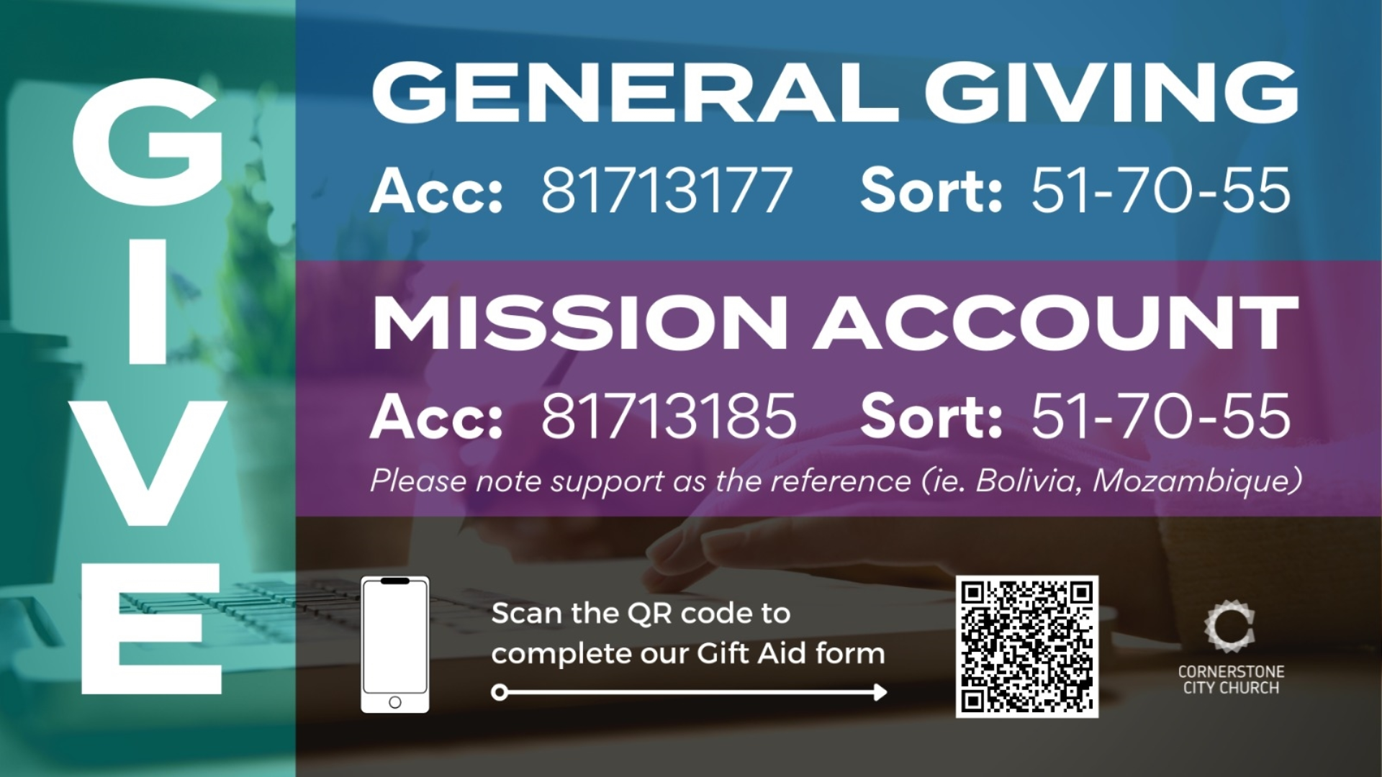

Slide 41
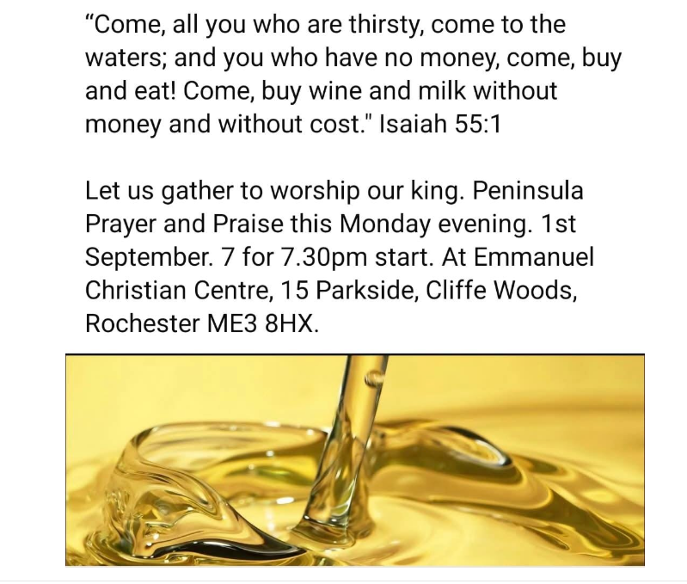

Slide 42
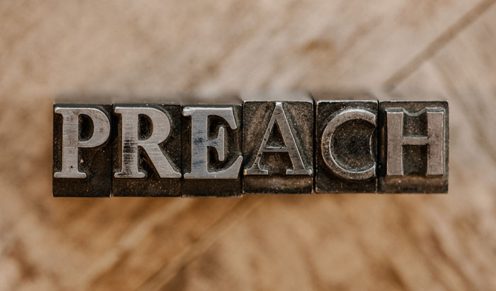

Slide 43
2 Corinthians 14 May the grace of the Lord Jesus Christ, and the love of God, and the fellowship of the Holy Spirit be with you all
Surely goodness and mercy shall follow us all the days of our lives, and we shall dwell in the house of the Lord forever.

